Slide 1


SQL project FAST FOOD NUTRITION
Muhammed Nasim MP

Slide 2

FAST FOOD
Welcome to the Fast Food Nutrition Dataset, which provides a comprehensive breakdown of the nutritional content of various fast food products from popular fast food chains.
Fast food is known for its convenience and affordability, but it is also infamous for its high-calorie, high-fat, and high-sugar content. This dataset aims to shed light on the nutritional value of these fast food products, helping consumers make more informed decisions about their food choices.
With information on calories, fat, carbohydrates, protein, and other key nutrients, this dataset provides a valuable resource for nutritionists, researchers, and health-conscious individuals. By analyzing this dataset, we can gain a better understanding of the nutritional impact of fast food consumption and work towards creating healthier food options in the fast food industry

Slide 3

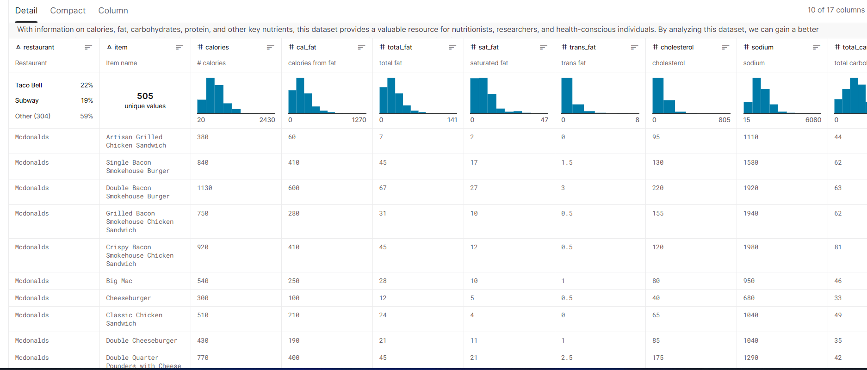
SAMPLE DATASET
Who benefits from this invention? Why?

Slide 4

QUERIES
Materials used for final inventin build
Why did you choose those materials?

Slide 5

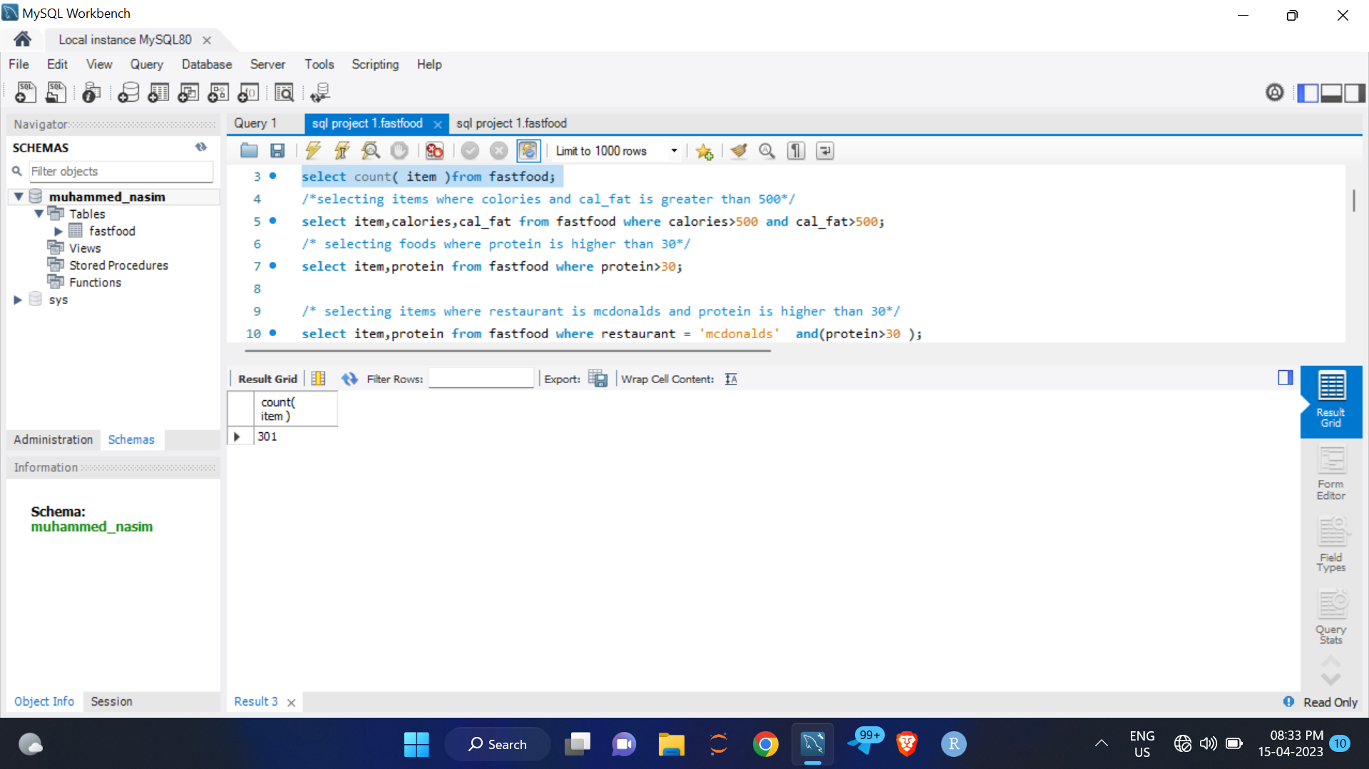
QUERY 1
How many items are there in this dataset?
select count( item )from fastfood;

Slide 6
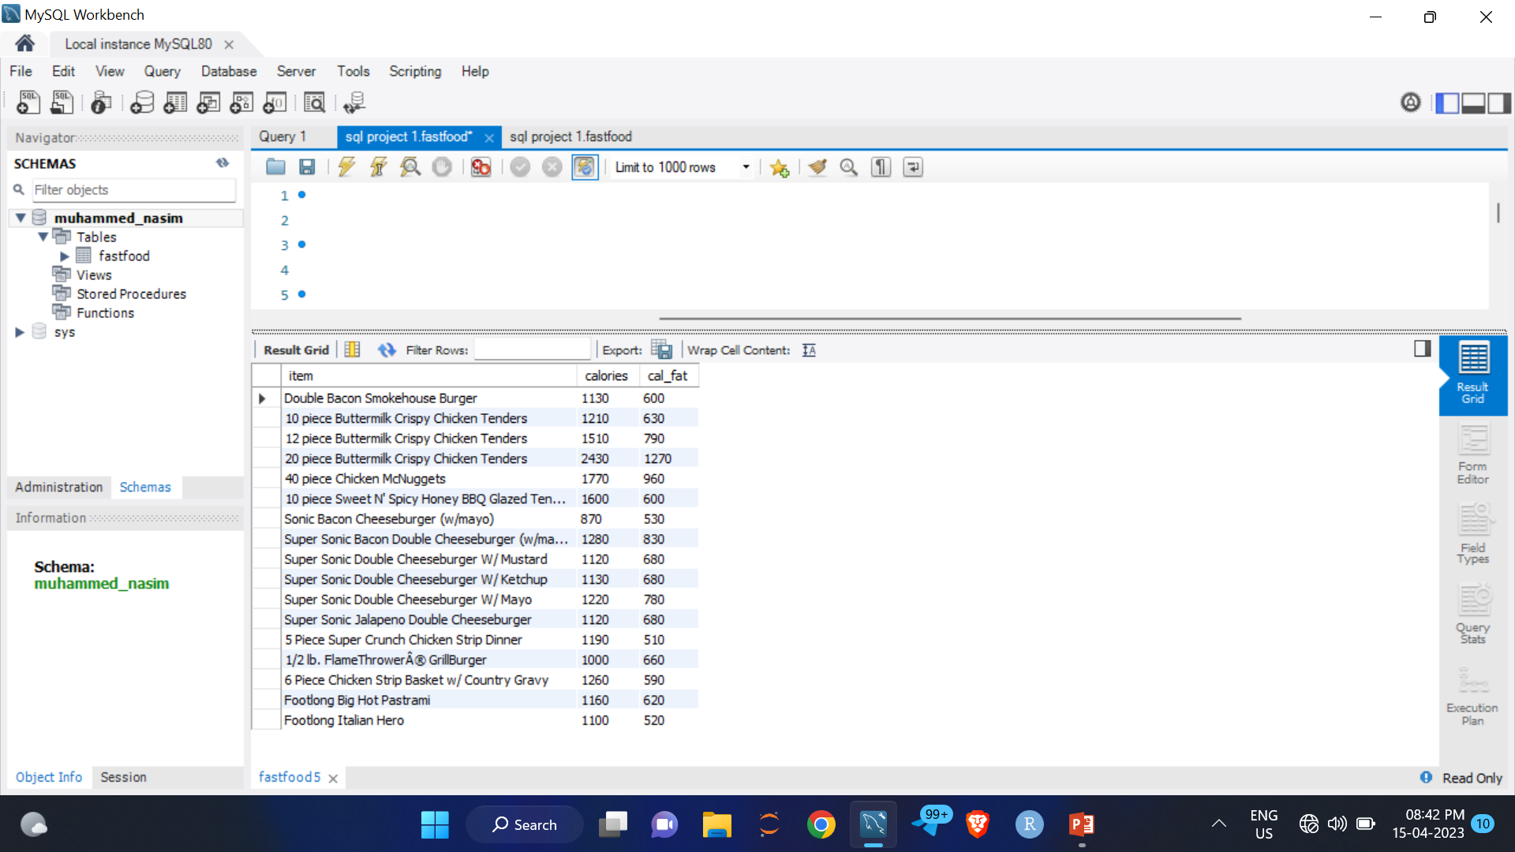
QUERY 2
What are the items where calories and cal_fat is greater than 500 ?
select item,calories,cal_fat from fastfood where calories>500 and cal_fat>500;

Slide 7
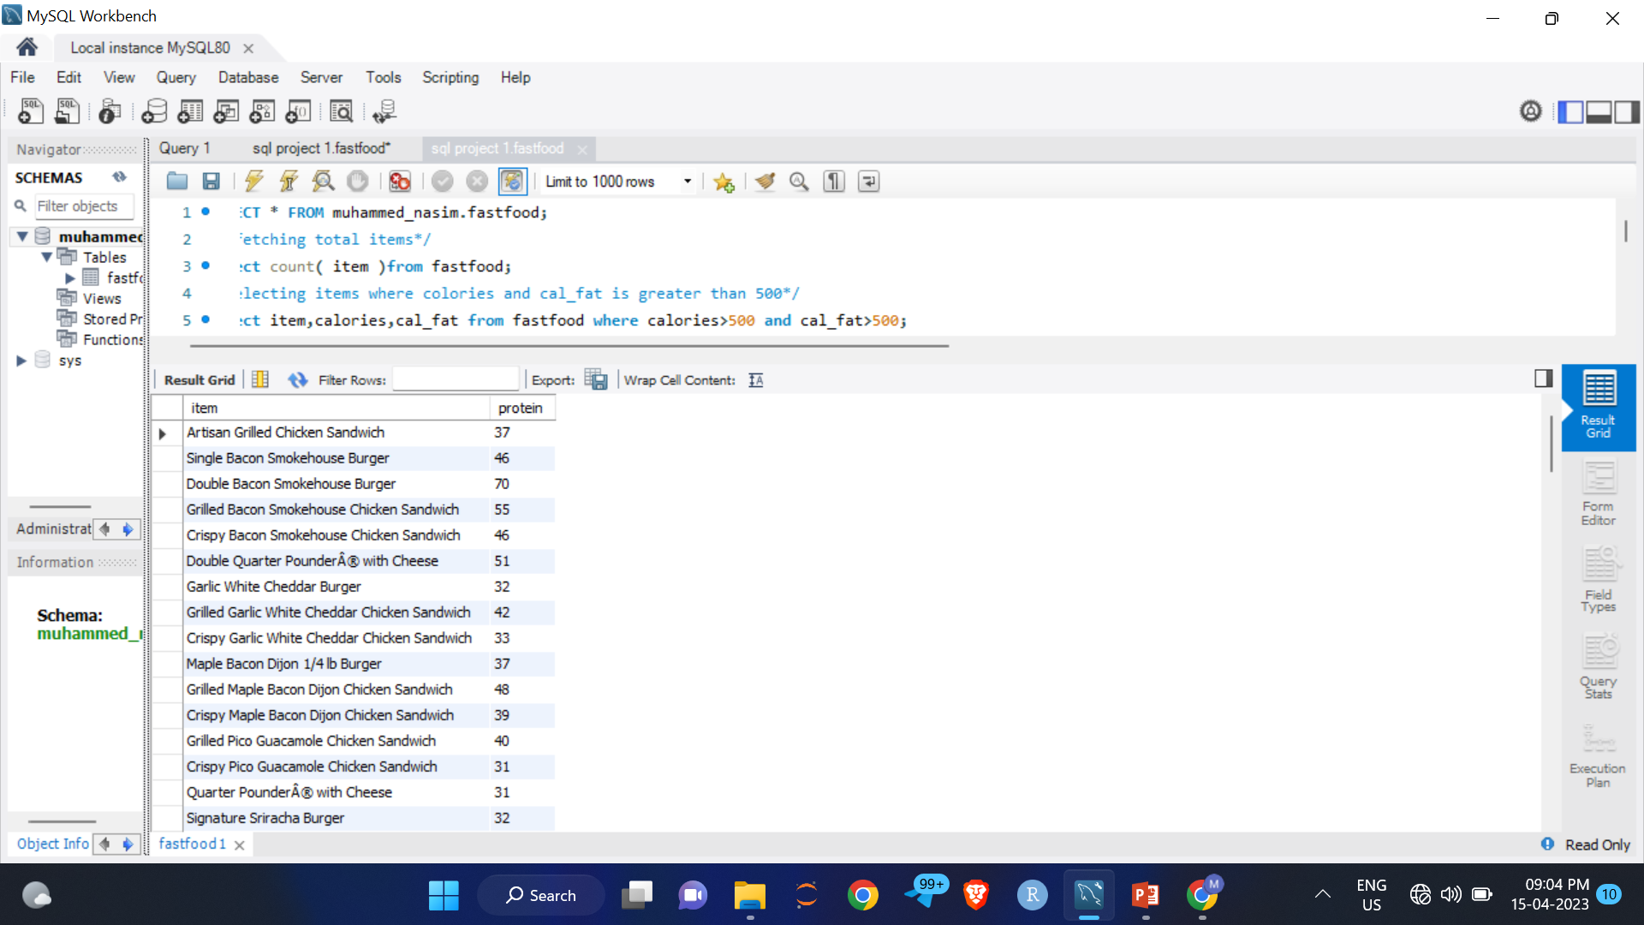

QUERY 3
What are the food items, that have protein more than 30
select item, protein from fastfood where protein>30;

Slide 8
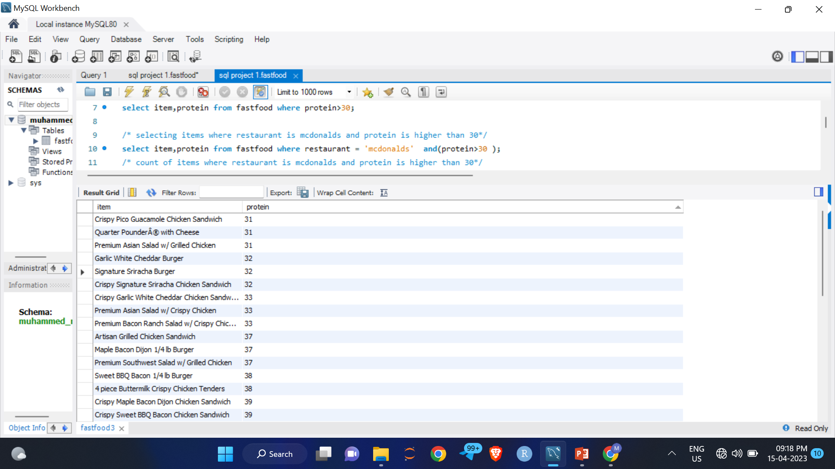
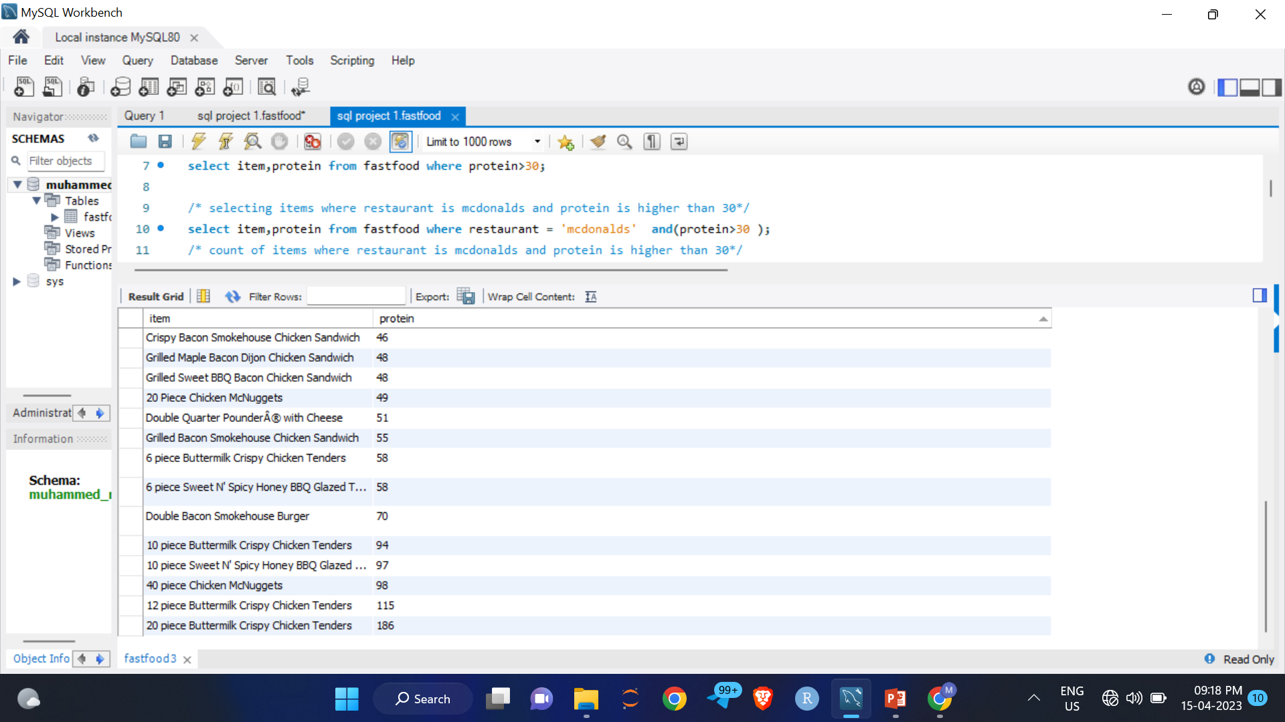
QUERY 4
Which mcdonalds item has protein more than 30
Select protein,item from fastfood where restaurant=mcdonalds and(protein>30);

Slide 9
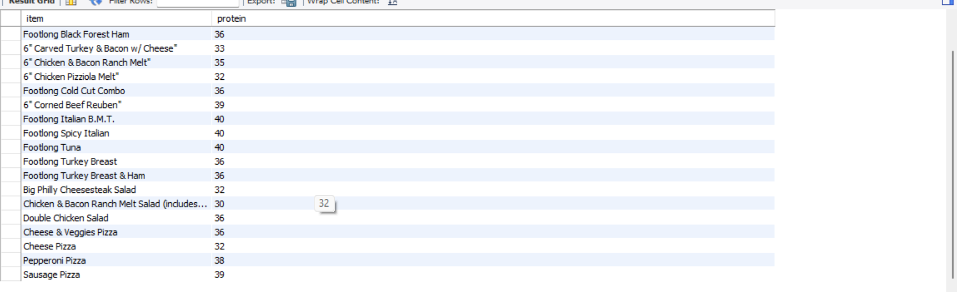
QUERY 5
What are the items in subway where protein stands btw 30_40
Select protein,item from fastfood where restaurant=mcdonalds and(protein between 30 and 40);

Slide 10
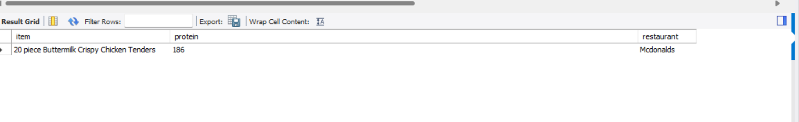
QUERY 5
which restaurant item has highest protein ?
Select item, protein,restaurant from fastfood where protein = (select max(protein) from fastfood);

Slide 11
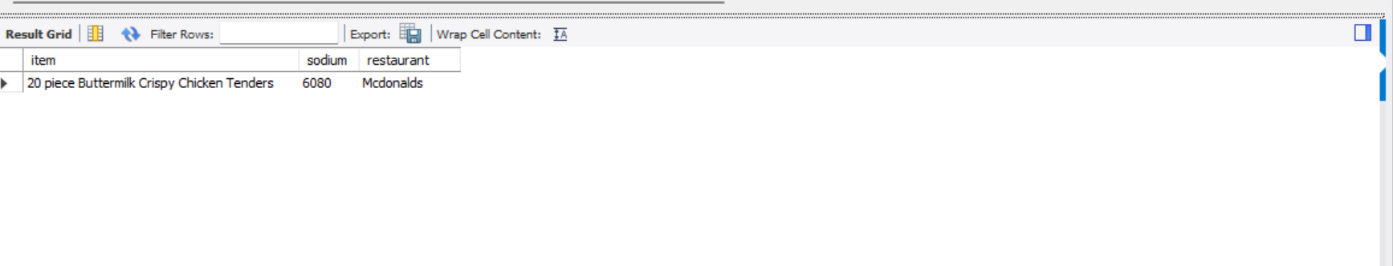
QUERY 6
which restauarant has highest sodium item?
Select item, sodium,restaurant from fastfood where sodium = (select max(sodium) from fastfood);

Slide 12
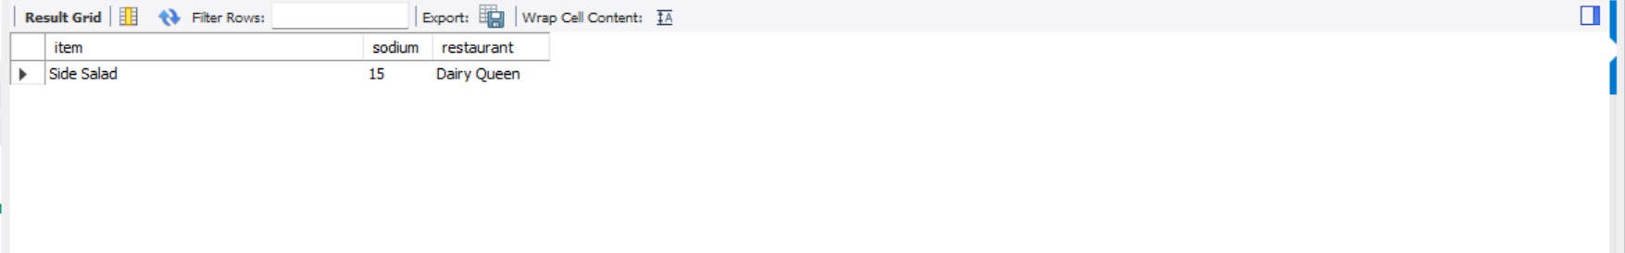
QUERY 7
which restaurant has lowest sodium item?
Select item, sodium,restaurant from fastfood where sodium = (select min(sodium) from fastfood);

Slide 13
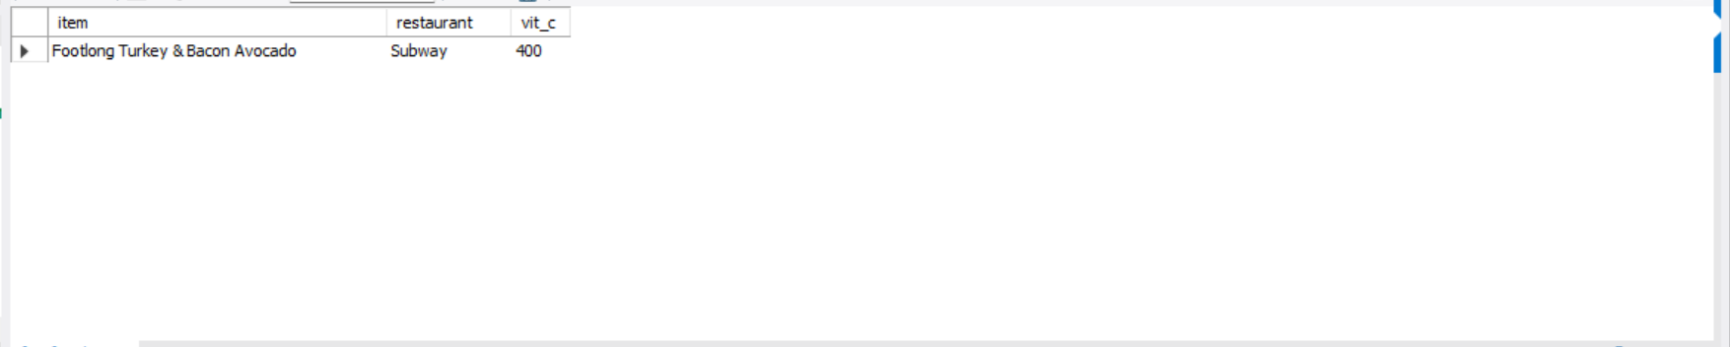
QUERY 8
which restaurant item has highest vitamin c ?
Select item, vit_c,restaurant from fastfood where vit_c= (select max(vit_c) from fastfood);

Slide 14
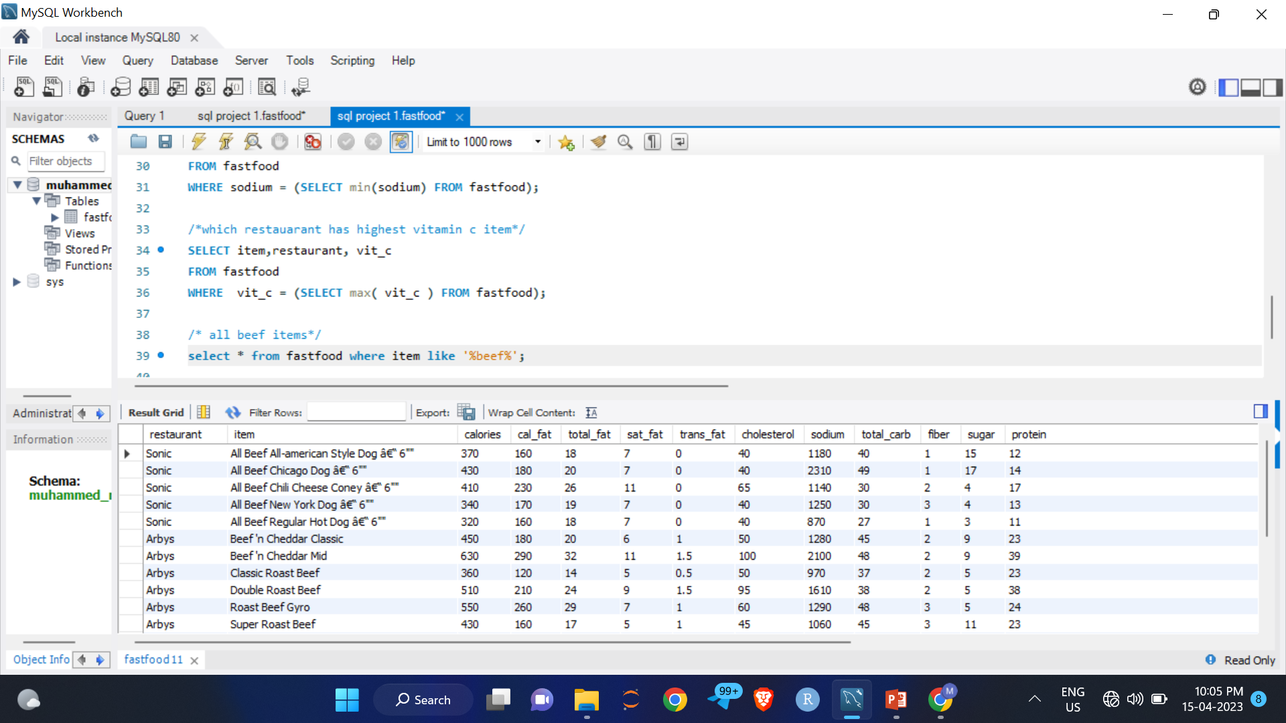
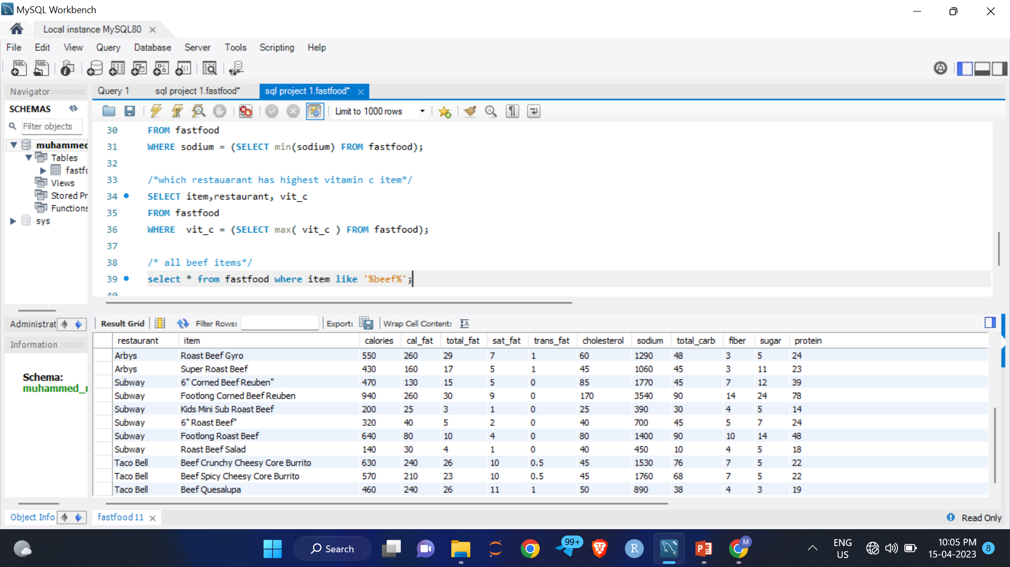
QUERY 9
What are the beef items in the item list?
select * from fastfood where item like '%beef%‘ ;

Slide 15
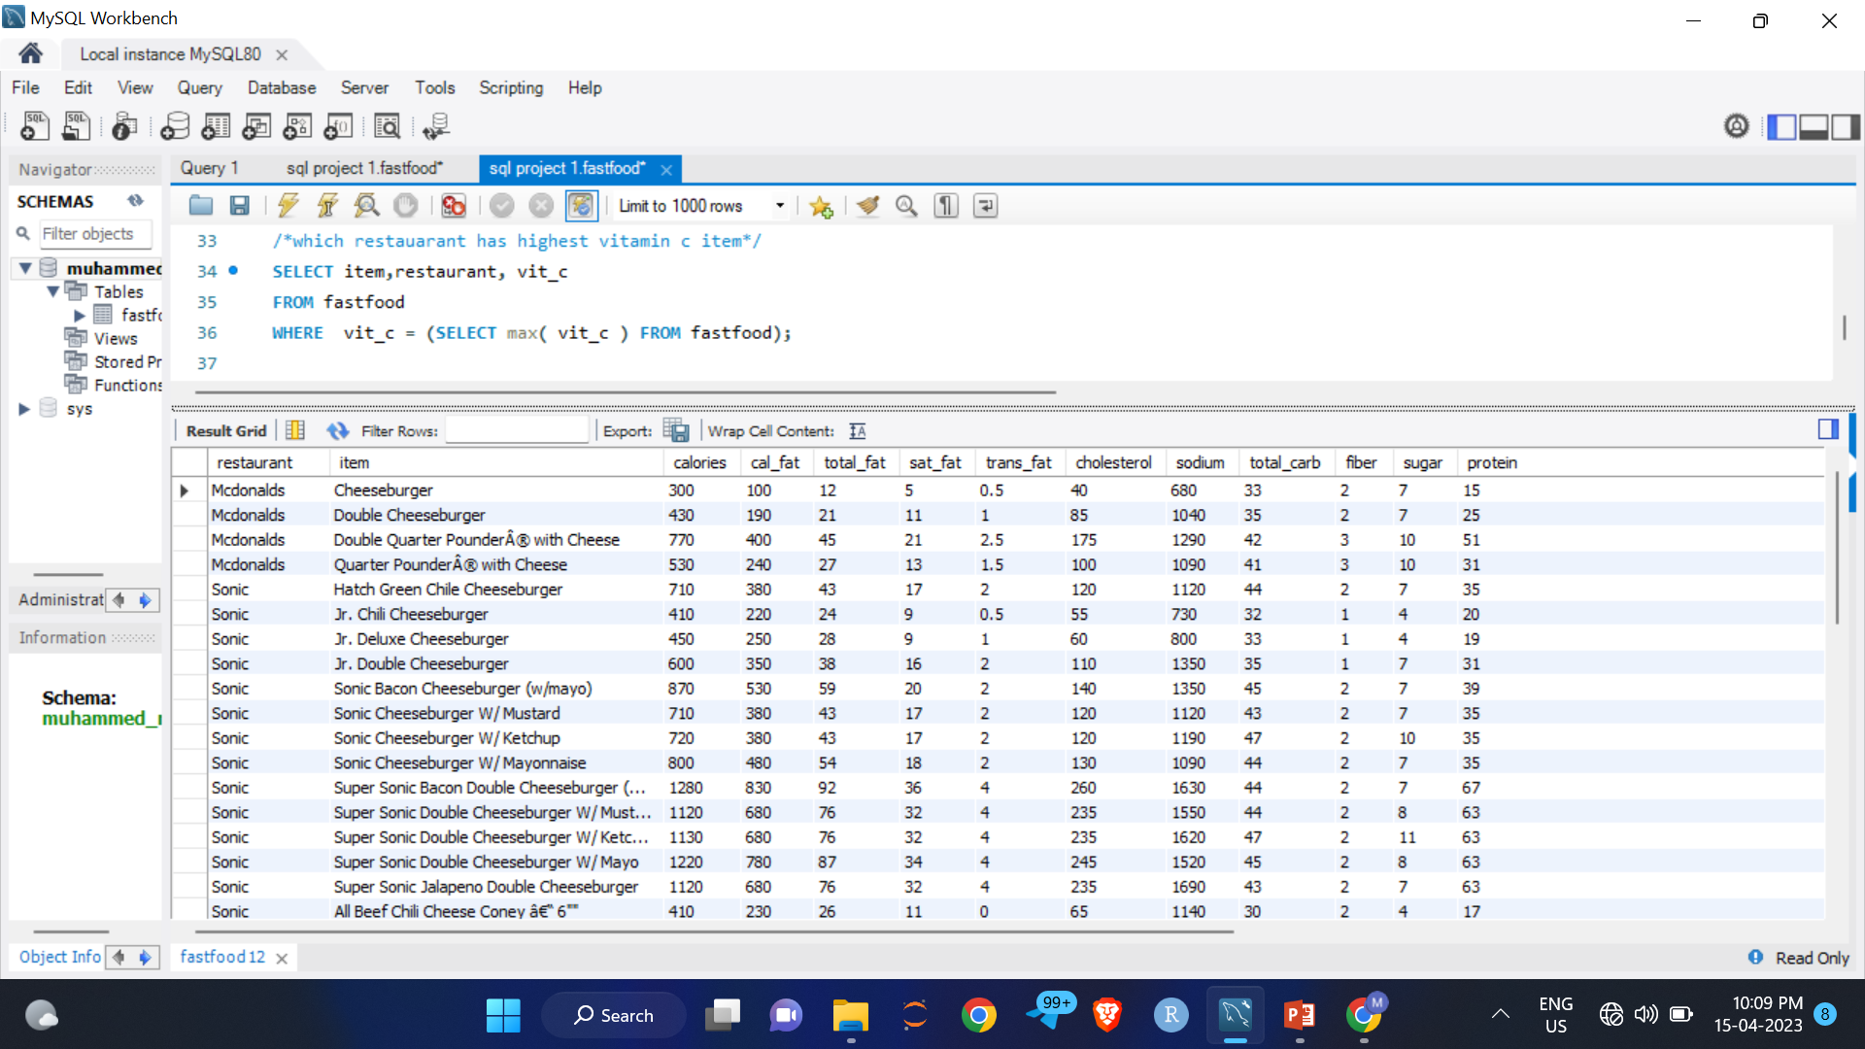
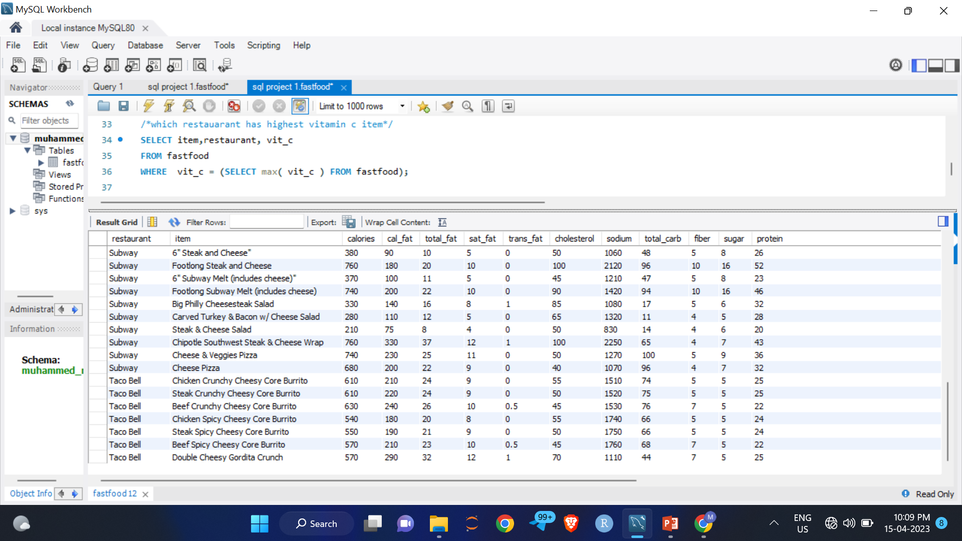
QUERY 10
What are the chees items in the item list?
select * from fastfood where item like '%chees%‘ ;

Slide 16
THANK YOU

